Slide 1
Interest rates reform and the impacts for the insurance
Eléonore Haguet-Trouplin, BNP Paribas Cardif
Patrice Odo,
Caisse des dépôts et consignations
May 11th – May 15th 2020

Slide 2
About the speaker
Eléonore Haguet-Trouplin
Actuary in risk management
After several years of life insurance consulting, I joined BNP Paribas Cardif to study the resilience of the company in the face of financial risks. I have been a member of the Finance and Asset Management Commission of the French Institute of actuaries for three years.
BNP Paribas Cardif

Slide 3
About the speaker
Patrice Odo
Actuary
With almost 15 years of experience in finance, I am responsible for monitoring portfolio management within the Financial Department of Savings Funds in order to manage the portfolio of assets linked to regulated deposits. I have been a member of the Finance and Asset Management Commission of the French Institute of actuaries for three years.
Caisse des dépôts et consignations

Slide 4
Agenda
Interbank rates
The need for a reform
The European reform
The other countries
The regulatory reform in insurance
Be continued…

Slide 5
Agenda
Interbank rates
The need for a reform
The European reform
The other countries
The regulatory reform in insurance
Be continued…

Slide 6
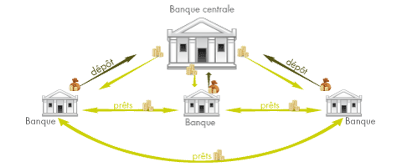
Interbank rates
Central Bank
What is an interbank rate?
Interbank rates are rates at which banks agree to lend
money to each other.
IBOR rates = Interbank Offered Rates
Ex : LIBOR, EURIBOR, EONIA
What’s the point?
All the economy is based on IBOR rates:
The volume dependent on these financial instruments is about €180 trillion for the EURIBOR and the volume is about USD 300 trillion for the LIBOR.
deposit
deposit
loans
loans
Bank
Bank
Bank
Bank
Bank
loans
loans
Corporate bonds
Swap
Student loans
Housing loans

Slide 7
Interbank rates
How are they determined?
A panel of contributing banks
An agency collects contributions
Elimination of extreme rates
Daily average of remaining rates
Declarations
Source : article of the monde 2015 « Pourquoi des traders ont manipulé le taux interbancaire Libor ? »

Slide 8
Agenda
Interbank rates
The need for a reform
The European reform
The other countries
The regulatory reform in insurance
Be continued…

Slide 9
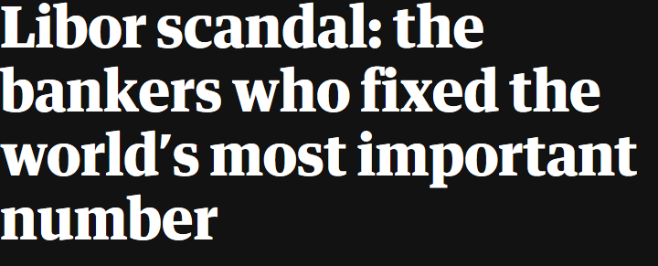
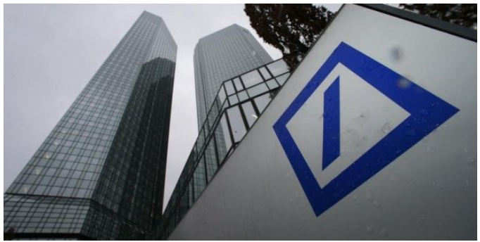
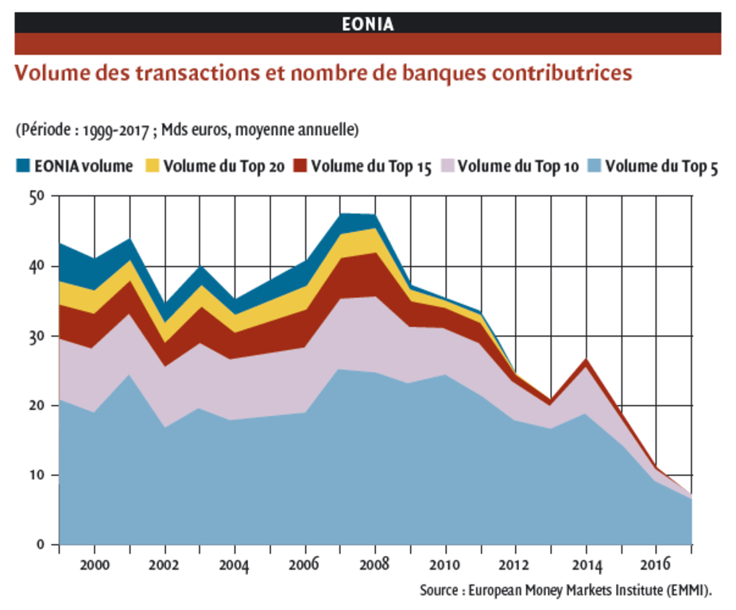
Which are the problems with current rates?
Manipulation scandals:
The guardian:
Financial Times:
Traded volumes deteriorate considerably after the subprime crisis:

Slide 10
Need for reform: The Benchmark Reglement
European benchmark adopted in June 2016
Definition of new requirements for benchmarks
Main missions:
People concerned:
Main rules
Limit conflicts of interest
Administrators
Volumes of real transactions
Implementation of fallback solutions
Contributors
Protect users
Restoring confidence
Users (Insurers)
The EURIOBOR, LIBOR and EONIA don’t comply the Regulation.

Slide 11
Agenda
Interbank rates
The need for a reform
The European reform
The other countries
The regulatory reform in insurance
Be continued…

Slide 12
The €STR Reform
2nd of October 2019
2nd of January 2022
Main differences between €STR and EONIA
Only EONIA is published
Transition period:
Publication of EONIA and €STR
EONIA = €STR + spread (8,5 bps)
Only €STR will be published
€STR
Administrator : ECB
Transaction volumes observed on the market.
Publication on T+1
EONIA
Administrator : EMMI
Bank declarations.
Publication on T
Actions to be implemented to ensure the transition :
Integration of the €STR curve in valuation models
Modification of existing contracts (fallback clauses)
Information systems migration
Accounting impacts and on risk management strategy
Others.

Slide 13
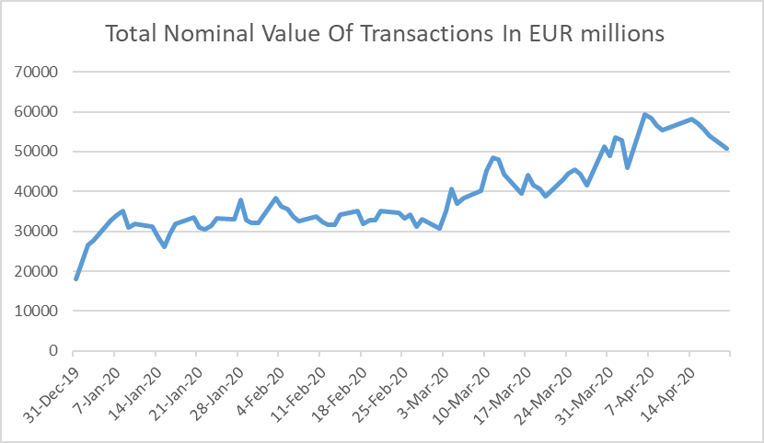
€str vs Covid19
Total Volume use to determine €str rate:
increased strongly as €str rate
is based on deposit rates.
€str linked swap:
Market players reduced
OIS swap linked to €str
Source: BCE
Source: LCH

Slide 14
EURIBOR® hybrid methodology
Level 1:
Contribution based solely on transactions in the Underlying Interest at the Defined Tenor from the prior TARGET day, using a formulaic approach provided by EMMI.
Level 2:
Contribution based on transactions in the Underlying Interest across the money market maturity spectrum and from recent TARGET days, using a defined range of formulaic calculation techniques provided by EMMI.
Level 3:
Contribution based on transactions in the Underlying Interest and/or other data from a range of markets closely related to the unsecured euro money market, using a combination of modelling techniques and/or the Panel Bank’s judgment.

Slide 15
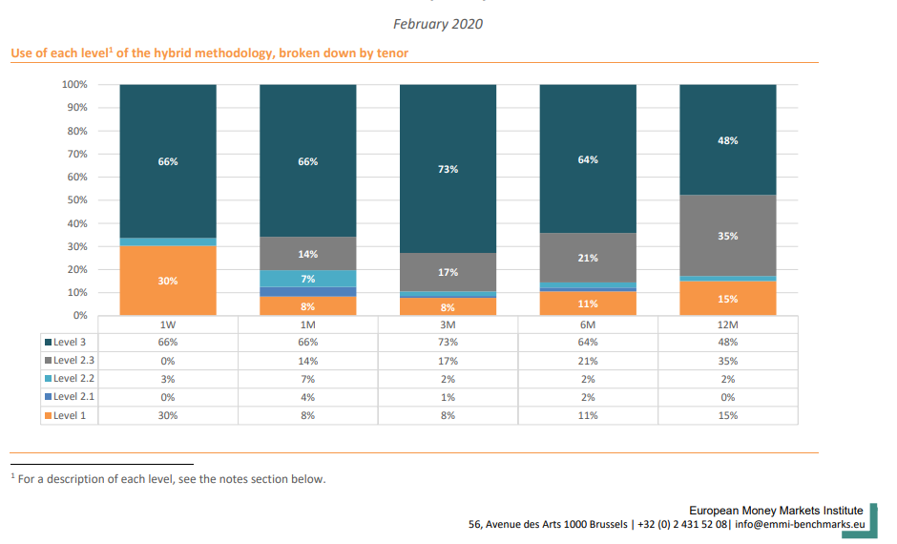
EURIBOR® hybrid methodology have to be improved

Slide 16
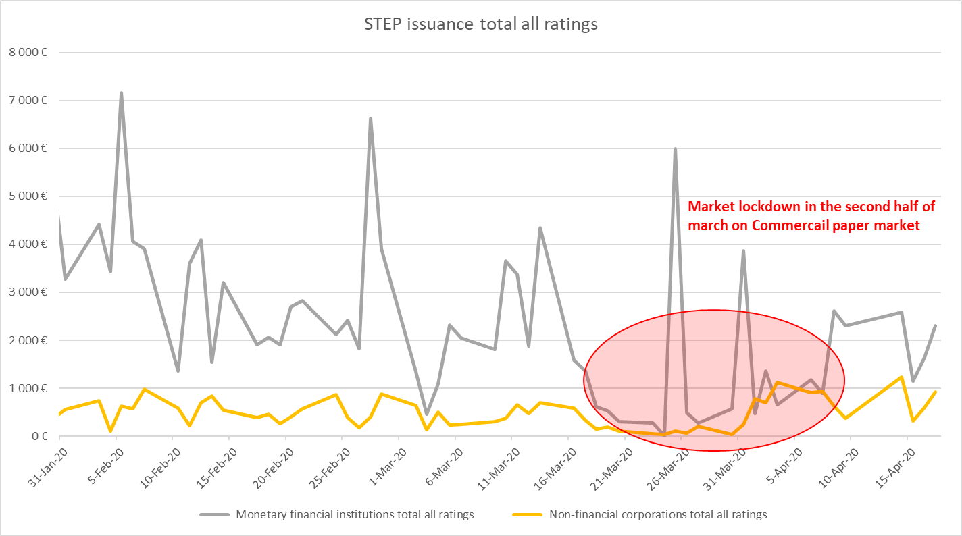
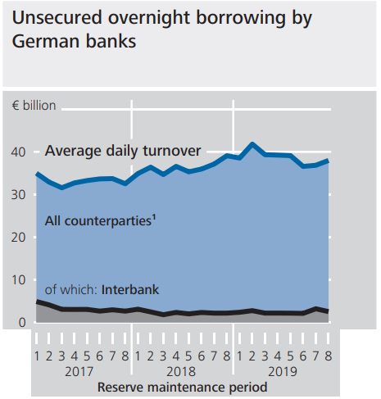
EURIBOR® hybrid methodology have to be improved
During time of crisis Level 3 should be very volatile
Source: BCE – STEP Data Source: BCE – STEP Data
Interbank market could be very difficult to follow .
In MMSR data in Germany, the share of the market accounted for
by interbank transactions is now only just under 7%
Source: Deutsche Bundesbank
Monthly Report March 2020

Slide 17
Agenda
Interbank rates
The need for a reform
The European reform
The other countries
The regulatory reform in insurance
Be continued…

Slide 18
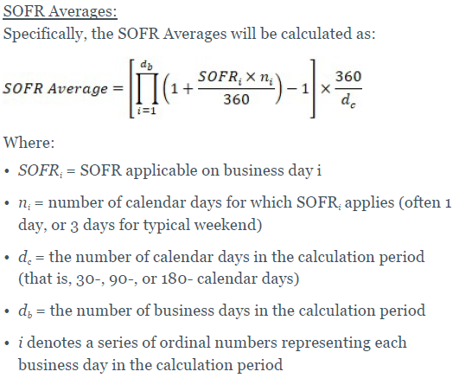
US: SOFR_{average} and SOFR_{index}
Since March 2, 2020, the Federal Reserve Bank of New York (New York Fed) publishes 30-, 90-, and 180-day SOFR Averages as well as a SOFR Index
Source: FED

Slide 19
UK: SONIA_{index}
Source: Bank of England Turbo-charging sterling LIBOR transition: why 2020 is the year for action – and what the Bank of England is doing to help

Slide 20
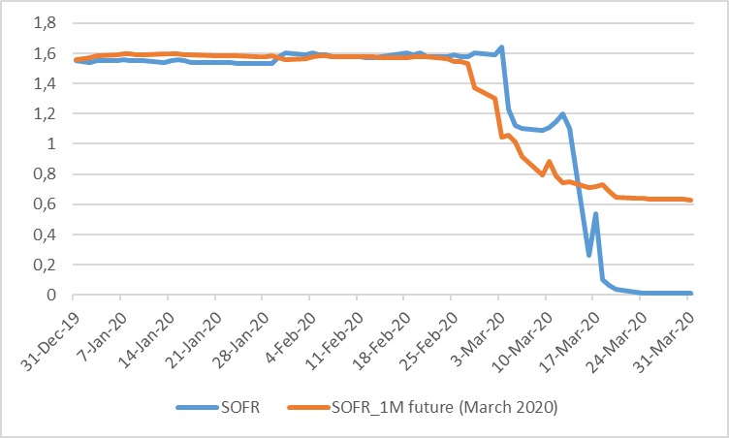
SOFR_{index} and SONIA_{index}
This period of uncertainty remind us that ex-ante rate and realized rate could be wide especially with credit risk.
Source: Bloomberg - CME
SOFR_{index} and SONIA_{index} seems to be useful for that

Slide 21
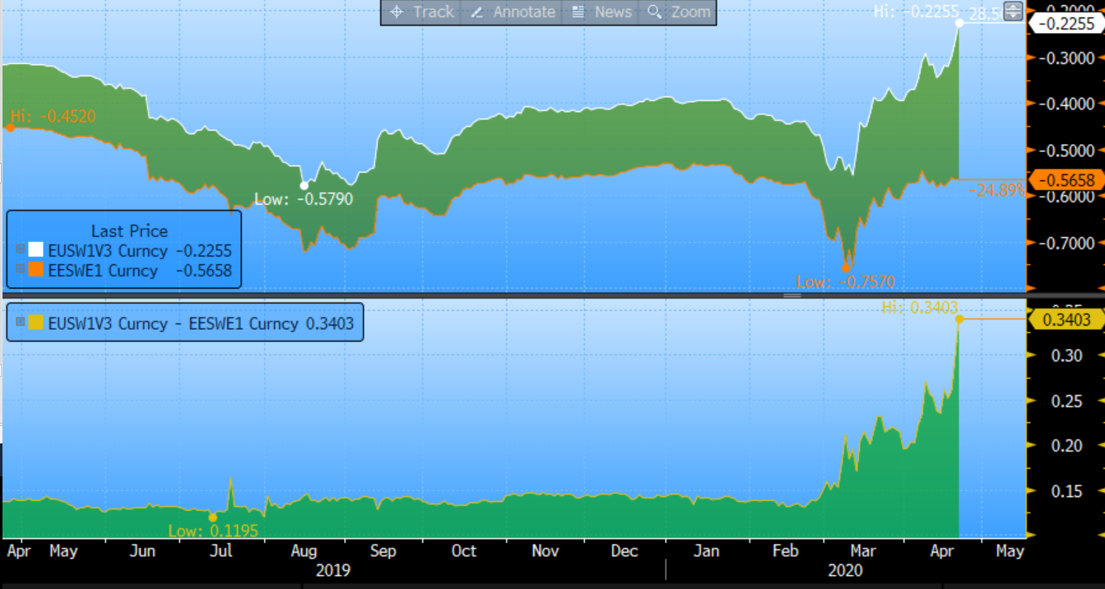
Historical spread ?
Eonia spread vs €STR has been fixed at 8,5pb based on the basis of daily Eonia and pre-€STR data from 17 April 2018 to 16 April 2019
But can we use spread to adjust Euribor vs €str or Libor vs Sonia?
ISDA proposed a 5 year period for Libor fallback but recent crisis could introduce a permanent spread that have to be discuss.
Source: Bloomberg
€str 1Yr swap vs Euribor_{3month} 1Yr swap

Slide 22
Agenda
Interbank rates
The need for a reform
The European reform
The other countries
The regulatory reform in insurance
Be continued…

Slide 23
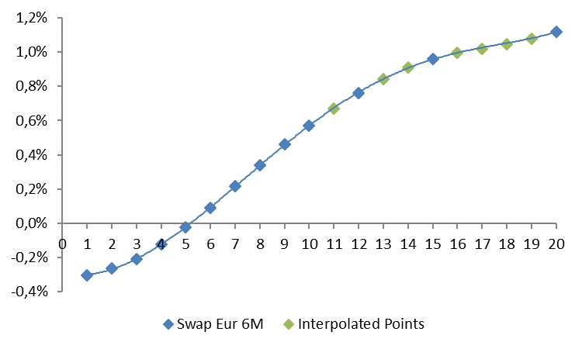
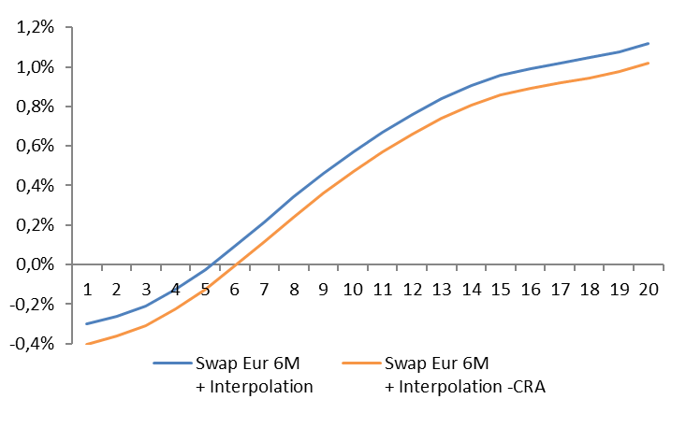
Regulatory developments
Under Solvency II, the technical provisions are based on the Best Estimate:
$$BE=\frac{1}{1000}×\sum_{i=1}^{1000}{\sum_{t=1}^{40}{\frac{{Cash_flow}_{i,t}}{{\left(1+r_{i,t}\right)}^{t}}}}$$
The rate curve of insurers $r_{i,t}$ is given by the EIOPA and is determined from 6 months Euribor swap rates with an interpolation for missing durations (1).
Then, the curve is retreated of the default risk that is contained in derivatives derived from IBOR rates: the Credit Risk Adjustment (CRA) (2).
The rate curve used by insurers, based on IBOR rates and EONIA, is impacted by the reform.
1. Interpolation of the Euribor swap rate
2. Application of the Credit Risk Adjustment
Calculous of the CRA :
Difference between IBOR rate and EONIA rate for same maturities.
The value is between 10 and 35 bps.

Slide 24
Regulatory developments
For the first time, EIOPA has launched a public consultation the February 6th 2020 on the IBOR transition. Participants has to respond until the 30th of April 2020. New deadline with Covid-19: the 30th of June 2020.
The focus of this paper is to identify the issues within the EIOPA Risk Free Rate (RFR) environment.
The old rates will need to be replace by the new ones. EIOPA wants to adopt a common approach across the EU to the transition to the new rates.
Old rates: Interbank Offered Rates (IBORs) Need a CRA to retreat the default risk
New rates: Over-Night Index Average rates (OIS) No need a CRA : risk free rate
The first result for the EIOPA RFR would be the end of the CRA according to the new rates.
The new rates have to respect the Deep Liquid Transparent (DLT) methodology before they can be included in the EIOPA RFR production.

Slide 25
Impact on the RFR structure
Which are criteria that the new IOS have to respect for the DLT methodology?
The average daily notional amount traded at least € 50 000 000,
The average daily number of trades is at least 10.
Currently none of the new OIS based curves can be considered DLT according to EIOPA’s criteria.
This can change rapidly with the development
of the derivatives market but we observe a
decrease on exchanged OIS swap rate
with the Covid-19 crisis.
Decrease: Covid 19 crisis?
Source: https://www.lch.com/services/swapclear/volumes/rfr-volumes

Slide 26
Agenda
Interbank rates
The need for a reform
The European reform
The other countries
The regulatory reform in insurance
Be continued…

Slide 27
To follow
Discount rate used by CPP have to be replace
LCH, Eurex and CME will use €str instead of Eonia on 22nd June 2020*
CME Group is targeting October 2020 to switch from daily effective federal funds rate (EFFR) to SOFR for US Swaps
€str compounded rate ?
EIOPA transition
Accounting implication for IASB
Publication Phase 1 :Sept 2019
Publication Phase 2: Aug 2020
*Delay may apply according to last ECB working group minute: https://www.ecb.europa.eu/paym/initiatives/interest_rate_benchmarks/WG_euro_risk-free_rates/shared/pdf/20200407/2020_04_07_WG_on_Euro_RFR_meeting_minutes.pdf

Slide 28
Thank you for your attention
Contact details :
ELEONORE HAGUET-TROUPLIN
eleonore.haguet-trouplin@bnpparibas.com
PATRICE ODO
patrice.odo@caissedesdepots.fr
https://www.actuarialcolloquium2020.com/

Slide 29
Disclaimer:
The views or opinions expressed in this presentation are those of the authors and do not necessarily reflect official policies or positions of the Institut des Actuaires (IA), the International Actuarial Association (IAA) and its Sections.
While every effort has been made to ensure the accuracy and completeness of the material, the IA, IAA and authors give no warranty in that regard and reject any responsibility or liability for any loss or damage incurred through the use of, or reliance upon, the information contained therein. Reproduction and translations are permitted with mention of the source.
Permission is granted to make brief excerpts of the presentation for a published review. Permission is also granted to make limited numbers of copies of items in this presentation for personal, internal, classroom or other instructional use, on condition that the foregoing copyright notice is used so as to give reasonable notice of the author, the IA and the IAA's copyrights. This consent for free limited copying without prior consent of the author, IA or the IAA does not extend to making copies for general distribution, for advertising or promotional purposes, for inclusion in new collective works or for resale.

